Slide 1

Python for Data Analytics- Project (Submission Date – 08th Jan 2024) Bindiya Singh

Slide 2
Title Data analysis on a merged dataset after cleaning
Objective:
The primary goal of the analysis is to merge and clean datasets related to energy indicators, GDP, and journal contributions in the field of Energy Engineering and Power Technology. The resulting DataFrame will be used for data analysis and derive insights related to GDP, energy supply, renewable energy, and population estimates.
Insights:
The study aims to investigate the association between energy and economic indicators using three datasets: population forecasts, economic indicators, and energy supply.
The study performs computations, transformations, and analyses on the datasets to extract information of various components, including GDP growth rate, energy consumption, share of renewable energy, contribution to scientific research, and population estimates.
The study provides a comprehensive understanding of the relationship between energy supply per capita and Citable Documents per capita by combining datasets and employing statistical techniques.
The insights derived from the analysis aim to shed light on the impacts of energy and economic factors on different countries and continents.

Slide 3
Description of Datasets and Variables in the project
Energy Dataset
EnergyIndicators.xlsx
World Bank Dataset
world_bank.csv
Scimagojr Dataset
Scimagojr-3.xlsx
"Environmental Indicators: Energy" is a dataset that focuses on "Energy Supply and Renewable Electricity Production in 2013." The key indicators provided for each country include:
Country: The name of the country for which the energy data is presented.
Energy Supply (Petajoules): This is the total energy supply for the selected country in the year 2013, measured in petajoules (PJ). Petajoule is a unit of energy equal to one quadrillion joules.
Energy Supply per Capita (Gigajoules): This represents the amount of energy supplied per capita, indicating the average energy availability per person. It is measured in gigajoules (GJ). A gigajoule is equal to one billion joules.
Renewable Electricity Production (%): This indicates the percentage of electricity production that comes from renewable sources. It provides insights into the country's reliance on renewable energy.
Source:-(http://unstats.un.org/unsd/environment/excel_file_tables/2013/Energy%20Indicators.xls)
The World Bank dataset, sourced from the World Development Indicators, provides information on the Gross Domestic Product (GDP) at market prices measured in constant 2010 US dollars for various countries. The data includes the following columns:
Country Name: The name of the country for which GDP data is reported.
Country Code: A unique code assigned to each country.
Indicator Name: The type of economic indicator, which, in this case, is "GDP at market prices (US$)."
Indicator Code: A unique code associated with the economic indicator.
Year Columns (1960-2015): The dataset includes columns for each year from 1960 to 2015, providing the GDP values(in US$) for those respective years.
The dataset shows the GDP values for specific countries over the specified time period. Each row represents a country, and the corresponding GDP values are presented in US dollars. This dataset allows for the analysis of economic trends, growth, and comparisons between countries based on their GDP performance.
Source: (http://data.worldbank.org/indicator/NY.GDP.MKTP.CD).
The Scimago Journal and Country Rank of Energy Engineering and Power
Technology dataset provides information on the scientific research output of various countries in the field of Energy Engineering and Power Technology. Here's a brief description of the columns:
Rank: The ranking of the country based on its scientific research output.
Country: The name of the country.
Documents: Total number of scientific documents published.
Citable documents: Number of documents that are considered citable, contributing to the country's scholarly impact.
Citations: Total number of citations received by the country's scientific documents.
Self-citations: Number of citations that come from the country's own documents.
Citations per document: Average number of citations received per scientific document.
H index: The Hirsch index, a metric that quantifies both the productivity and impact of a country's scientific research output. The H-index provides a balance between the quantity (number of publications) and impact (citation counts) of an individual's work.
The dataset shows the top-ranking countries in terms of their scientific contributions in the specified field. It includes key metrics such as the number of documents, citations, and the H index, offering insights into the research impact and influence of each country.
Source: (http://www.scimagojr.com/countryrank.php?category=2102)

Slide 4
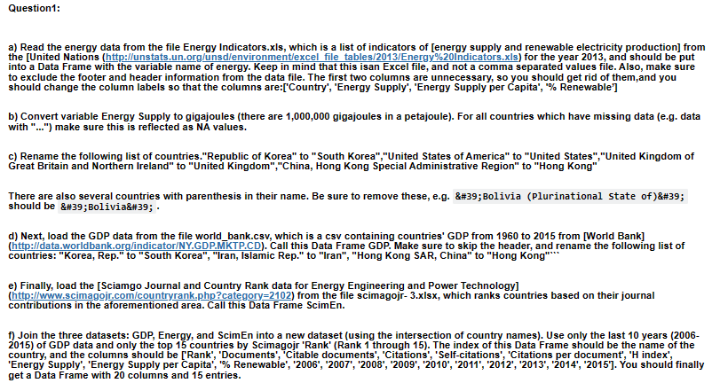
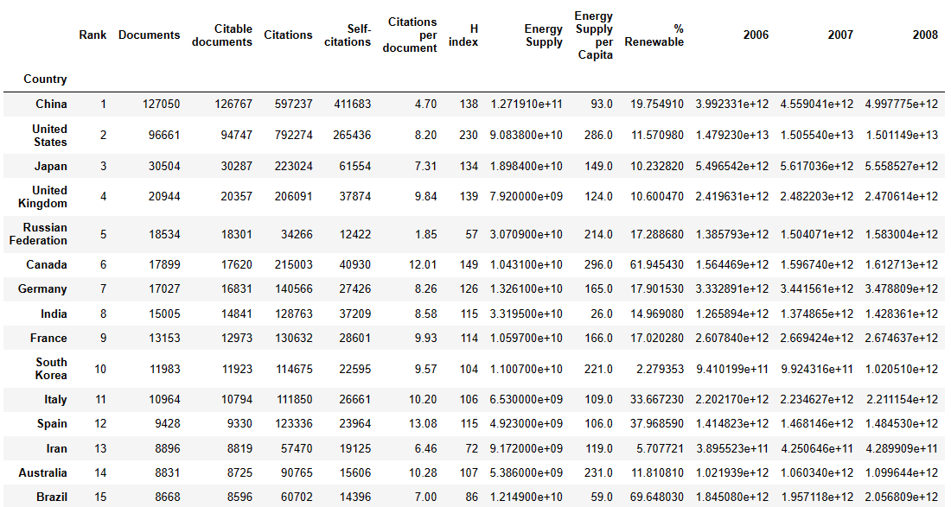
Data Analysis
Q1)
Methodology:
Energy Data (Q1a-c): Loaded energy data from Energy Indicators.xls, removed header and footer, dropped unwanted columns, converted energy supply to gigajoules, and cleaned country names. Renamed specified countries, removed parentheses and digits from country names.
GDP Data (Q1d): Loaded GDP data from world_bank.csv, skipped the header, and renamed specified countries.
ScimEn Data (Q1e): Loaded Sciamgo Journal and Country Rank data for Energy Engineering and Power Technology from scimagojr-3.xlsx.
Merge Datasets (Q1f): Joined GDP, Energy, and ScimEn datasets into a new dataset using the intersection of country names and with the index as country name. Selected the last 10 years of GDP data and top 15 countries by Scimagojr Rank.
Analysis (Q2-Q12): Utilized the merged dataset to answer various questions related to GDP, energy supply, renewable energy, and population estimates.

Slide 5
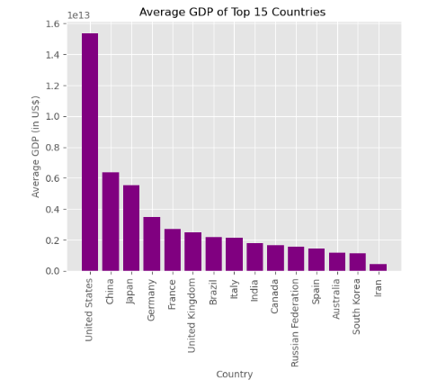
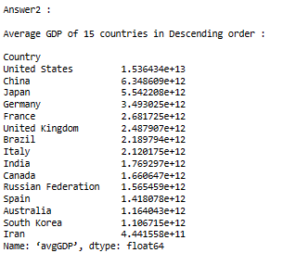
Data Analysis
Question 2: What are the top 15 countries for average GDP over the last 10 years? [NB: This function should return a Series named ‘avgGDP’ with 15 countries and their average GDP sorted in descending order.]
Output:
Key Findings:
United States has highest average GDP ranked at 1st position followed by China and Japan

Slide 6
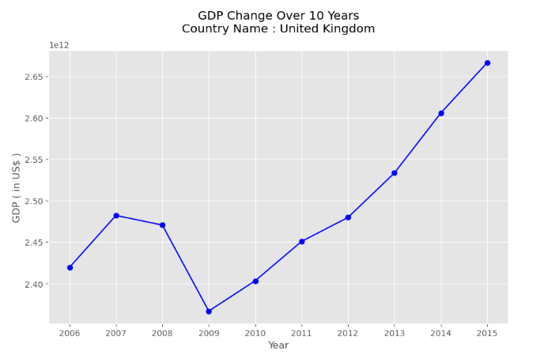
Data Analysis
Question 3 : By how much had the GDP changed over the 10 year span for the country with the 6th largest average GDP? [NB: This function should return a single number.]
Output:
Key Findings:
The GDP Change over the span of 10 years for United Kingdom is US$ 246702696075.4.
It indicates that the overall value of goods and services produced within a country's borders has expanded.

Slide 7
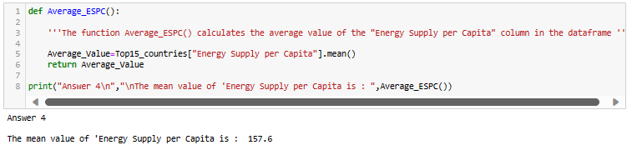
Data Analysis
Question 4 : What is the mean energy supply per capita? [NB: This function should return a single number.]

Slide 8
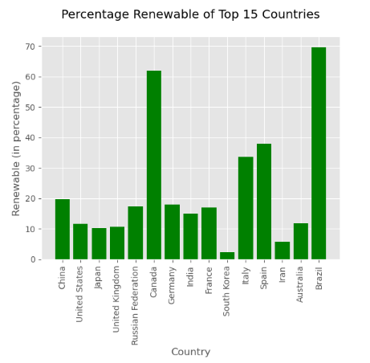
Data Analysis
Question 5 : Which country has the maximum % Renewable and what is the percentage? [NB: This function should return a tuple with the name of the country and the percentage.]
Key Findings:
Top 2 countries with the maximum percentage renewable is Brazil and Canada . This indicates the percentage of electricity production that comes from renewable sources are highest in these countries which belongs North America and South America Continents

Slide 9
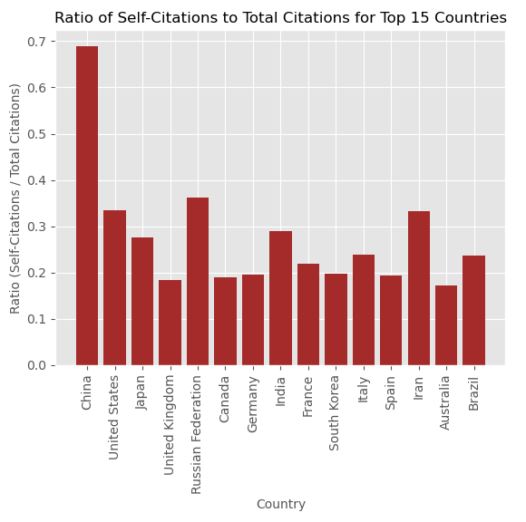
Data Analysis
Question 6 : Create a new column that is the ratio of Self-Citations to Total Citations. What is the maximum value for this new column, and which country has the highest ratio? [NB: This function should return a tuple with the name of the country and the ratio.]¶
Key Findings:
The country with the highest Citation ratio is China. The country cites maximum its own work as compared to all other countries

Slide 10
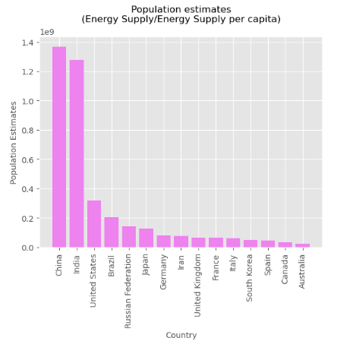
Data Analysis
Question 7 : Create a column that estimates the population using Energy Supply and Energy Supply per capita. What is the third most populous country according to this estimate? [NB: This function should return a single string value.]
Key Findings:
China is at first position followed by India and then United states.
Recommendations:
Energy Efficiency Programs: The countries with higher population estimates should implement energy efficiency programs to optimize energy consumption. This can help in sustaining the higher population without excessively increasing the demand for energy resources.
Example-Weatherization programs: Improving insulation, sealing leaks, and upgrading windows to reduce heating and cooling energy needs.
Public Awareness Campaigns: Educate the public about the importance of energy conservation and provide tips on reducing energy consumption in daily activities.

Slide 11
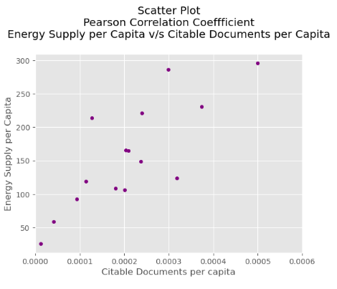
Data Analysis
Question 8 : Create a column that estimates the number of citable documents per person. What is the correlation between the number of citable documents per capita and the energy supply per capita? Use the “.corr()” method, (Pearson's correlation). [NB: This function should return a single number.] Plot to visualize the relationship between Energy Supply per Capita vs. Citable docs per Capita.
Key Findings:
Strong positive association and High linear correlation exists between Energy Supply per capita and Citable Documents per capita and it tend to move in the same direction .
Recommendation:
Positive correlation between Energy Supply per capita and Citable documents per capita can be valuable for countries seeking to enhance their global competitiveness in research, innovation, and sustainable energy development.

Slide 12
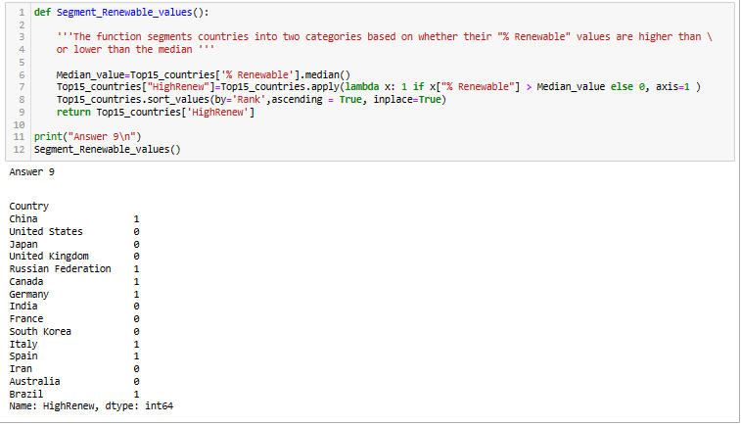
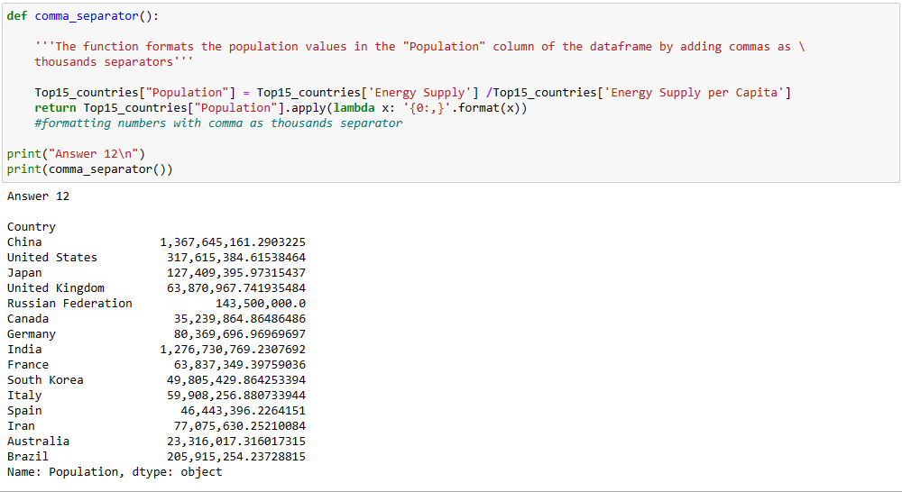
Data Analysis
Question 9 : Create a new column with a 1 if the country's % Renewable value is at or above the median for all countries in the top 15, and a 0 if the country's % Renewable value is below the median. [NB: This function should return a series named “HighRenew” whose index is the country name sorted in ascending order of rank.]
Question 12 : Convert the Population Estimate series to a string with thousands separator (using commas). Do not round the results. e.g. 317615384.61538464 -> 317,615,384.61538464
Recommendation:
Research and Development: The countries with % Renewable value lower than median should allocate resources to research and development initiatives aimed at improving renewable energy technologies. This can involve collaboration with academic institutions, private sectors, and international organizations to foster innovation.

Slide 13
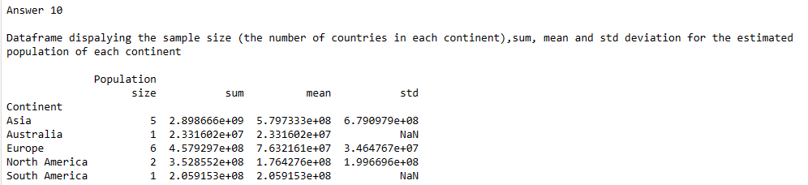
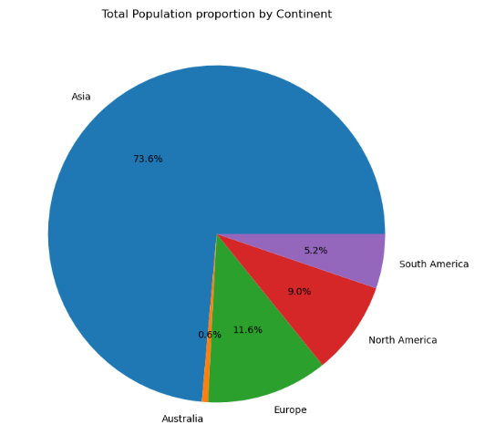
Data Analysis
Question 10 : Use the following dictionary to group the Countries by Continent, then create a DataFrame that displays the sample size (the number of countries in each continent bin), and the sum, mean, and std deviation for the estimated population of each continent.
[NB: This function should return a DataFrame with index named Continent ['Asia', 'Australia', 'Europe', 'North America', 'South America'] and with columns ['size', 'sum', 'mean', 'std'].]
Key Findings:
Europe dominates the list with 6 countries in the top 15 ranks followed by Asia with 5 countries and this suggests a strong scientific presence and research output in the continent.
73.6% of the total population belongs to Asia followed by Europe then North America .

Slide 14
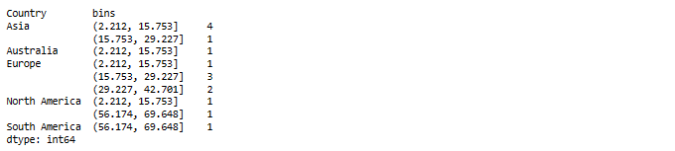
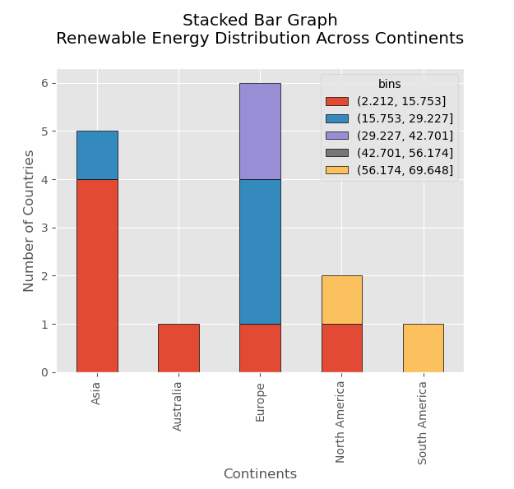
Data Analysis
Question 11 : Cut % Renewable into 5 bins. Group Top15 by the Continent, as well as these new % Renewable bins. How many countries are in each of these groups? [NB: This function should return a Series with a MultiIndex of ‘Continent’, then the bins for ‘% Renewable’. Do not include groups with no countries.]
Key Findings:
Asia has maximum countries in bin 1 , the lowest bin .
The percentage of electricity production that comes from renewable sources are highest in North and South America Continent
Recommendations:
The continents with lower percentage of renewable energy like Asia & Australia could consider increasing investments in renewable energy projects and should diversify their renewable sources
Further development of solar, wind, hydro, or other sustainable energy sources is needed to capitalize the strengths.

Slide 15
Conclusion In conclusion, the findings contribute to a deeper understanding of the direct and indirect relationships between population, energy supply, and renewable rates contributing to further optimizing the energy structure of each country.

Slide 16
Thank You

